Slide 1

ER Model from scenario
Afjal H. Sarower
Lecturer, Department of CSE,DIU

Slide 2
Draw an ER diagram for the given scenario;
Suppose that you are designing a schema to record information about reality shows on TV. Your database needs to record the following information:
_ For each reality show, its name, genre, basic-info and participants name. Any reality show has at least two or more participants.
_ For each producer, the company name, company country. A show is produced by exactly one producer. And one producer produces exactly one show.
_ For each television, its name, start year, head office. A television may broadcasts multiple shows. Each show is broadcasted by exactly one television.
_ For each user, his/her username, password, and age. A user may rate multiple shows, and a show may be rated by multiple users. Each rating has a score of 0 to 10.

Slide 3
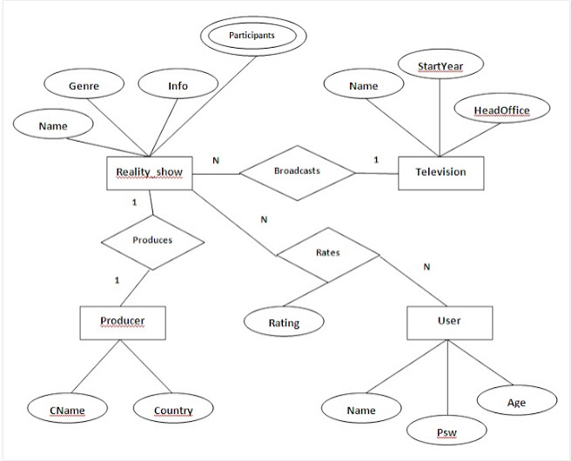
Example 1 Solution

Slide 4
Draw an ER diagram for the given scenario;
A company has several departments.
Each department has a supervisor and at least one employee.
Employees must be assigned to at least one, but possibly more department.
At least one employee is assigned to a project, but an employee may be on vacation and not assigned to any project.

Slide 5
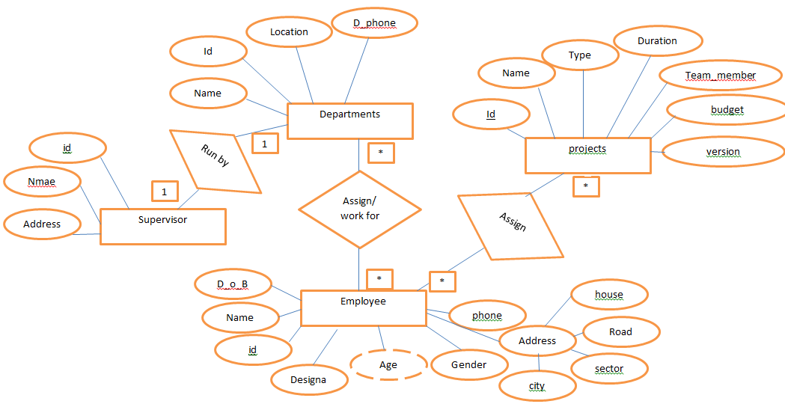
Example 2 Solution

Slide 6
Draw an ER diagram for the given scenario;
The motor vehicle branch administers driving test and issues drivers license.
Any person who wants a drivers license must first take a learner exam at any motor vehicle branch in the province.
If he/she fails the exam, he/she can take the exam again any time after a week of the failed exam date, at any brunch.
If he passes the exam, he is issued a learner license with a unique number and expiry date.
A learner license may contain a single restriction on it.
A person may take his drivers exam at any brunch any time before the learners license expiry date.
If he passes the exam the brunch issues him a driver license.
A driver license must also record if the driver has completed drivers education, for insurance purpose.

Slide 7
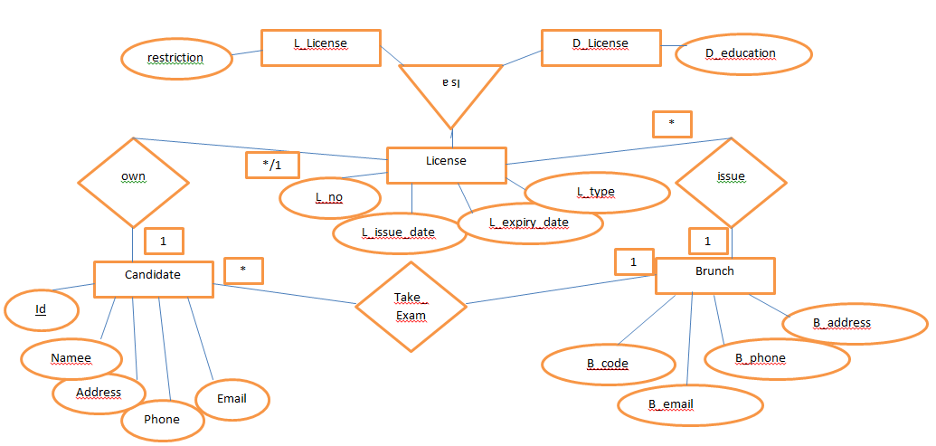
Example 3 Solution

Slide 8
Thank you

